Slide 1
Continuity and controversy: the Withdrawal Bill (nee the Great Repeal Bill)
Prof Rory O’Connell
Transitional Justice Institute and School of Law, Ulster University
Member of BrexitLawNI
@rjjoconnell
r.oconnell@ulster.ac.uk

Slide 2
“Effecting the UK’s withdrawal from the European Union and the implementation of a new relationship will be arguably
the most complex, demanding and important administrative and diplomatic task that the Government
has undertaken since the Second World War.”
Select Committee on the European Union, 1st Report - Scrutinising Brexit: the role of Parliament (House of Lords, London 2016-2017) HL 33 para 30

Slide 3
Origins

Slide 4
Withdrawal Bill
European Communities Act 1972
Great Repeal Bill
One of at least nine statutes needed

Slide 5
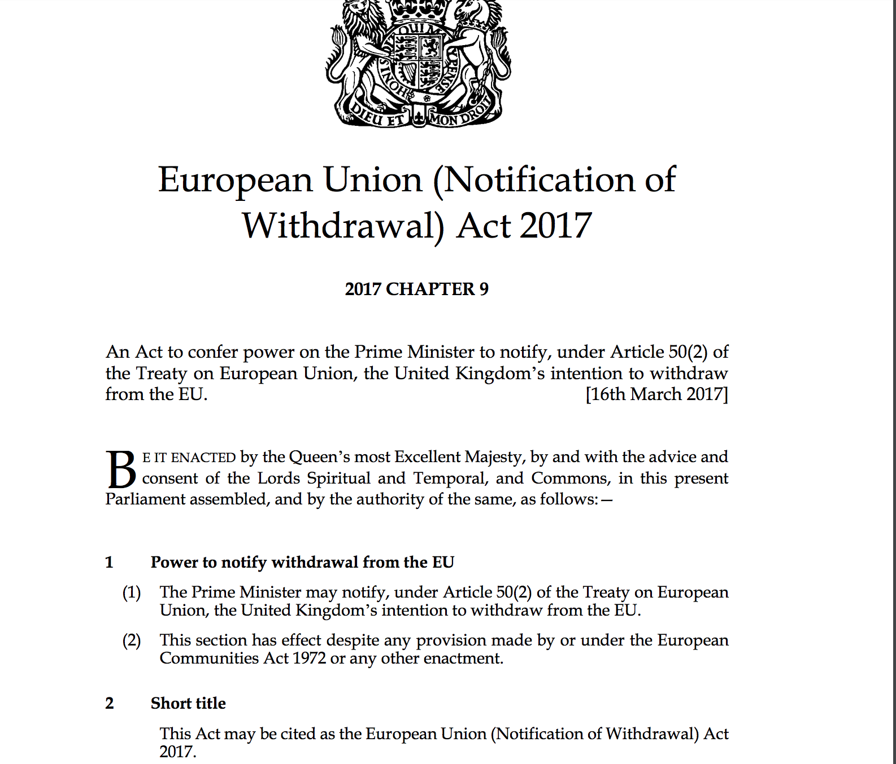
Notification

Slide 6
Customs Bill
Trade Bill
Immigration Bill
Fisheries Bill
Agriculture Bill
Nuclear Safeguards Bill
International Sanctions Bill

Slide 7
Withdrawal Agreement and Implementation Bill

Slide 8
Withdrawal Bill

Slide 9
Withdrawal Bill
Commons
One defeat
Current stage:
Report stage in Lords
Two defeats

Slide 10
Withdrawal Bill
Challenge
Three key steps
Controversies

Slide 11
Challenge:
But when we come to matters with a European element, the Treaty is like an incoming tide. It flows into the estuaries and up the rivers. It cannot be held back. Parliament has decreed that the Treaty is henceforward to be part of our law. It is equal in force to any statute. ….
The statute (ECA 1972] is expressed in forthright terms which are absolute and all-embracing. Any rights or obligations created by the Treaty are to be given legal effect in England without more ado. Any remedies or procedures provided by the Treaty are to be made available here without being open to question. In future, in transactions which cross the frontiers, we must no longer speak or think of English law as something on its own. We must speak and think of Community law, of Community rights and obligations, and we must give effect to them. This means a great effort for the lawyers. We have to learn a new system.
Bulmer v Bollinger [1974] Ch 401, 418.

Slide 12
Challenge: How much EU law?
Not certain
EU Treaty provisions
5155 regulations
243 delegated regulations and 1929 Implementing regulations
899 directives
7522 Decisions
Vaughne Miller, Legislating for Brexit: directly applicable EU law (House of Commons Library paper 2017)

Slide 13
Withdrawal Bill
1 Repeal of ECA 1972

Slide 14
Saving
Retained EU law
2 ‘EU-derived domestic legislation’
3 Incorporation of direct EU legislation
4 powers, rights, liabilities etc under ECA s 2(1)

Slide 15
Exceptions
5 (1) The principle of the supremacy of EU law does not apply to any enactment or rule of law passed or made on or after exit day
5 (4) The Charter of Fundamental Rights is not part of domestic law on or after exit day.

Slide 16
Power to change
Clauses 7, 8, 9

Slide 17
Clause 7
Dealing with deficiencies
(1) A Minister of the Crown may by regulations make such provision as the Minister considers appropriate to prevent, remedy or mitigate— (a) any failure of retained EU law to operate effectively, or (b) any other deficiency in retained EU law, arising from the withdrawal of the United Kingdom from the EU.
(2) Deficiencies in retained EU law include (but are not limited to) [ORIGINAL TEXT] where the Minister considers that retained EU law ….
(4) Regulations under this section may make any provision that could be made by an Act of Parliament.

Slide 18
Clause 7
(6) But regulations under this section may not—
(a) impose or increase taxation,
(b) make retrospective provision,
(c) create a relevant criminal offence,
(d) be made to implement the withdrawal agreement,
(e) amend, repeal or revoke the Human Rights Act 1998 or any subordinate legislation made under it, or
(f) amend or repeal the Northern Ireland Act 1998 (unless the regulations are made by virtue of paragraph 13(b) of Schedule 7 to this Act or are amending or repealing paragraph 38 of Schedule 3 to the Northern Ireland Act 1998 or any provision of that Act which modifies another enactment).
(7) No regulations may be made under this section after the end of the period of two years beginning with exit day.

Slide 19
Clause 8
Complying with International Obligations

Slide 20
Clause 9
[ORIGINAL TEXT]
(1) A Minister of the Crown may by regulations make such provision as the Minister considers appropriate for the purposes of implementing the withdrawal agreement if the Minister considers that such provision should be in force on or before exit day.
(2) Regulations under this section may make any provision that could be made by an Act of Parliament (including modifying this Act).
(3) But regulations under this section may not— (a) impose or increase taxation, (b) make retrospective provision, (c) create a relevant criminal offence, or (d) amend, repeal or revoke the Human Rights Act 1998 or any subordinate legislation made under it.
(4) No regulations may be made under this section after exit day.

Slide 21
Controversies
Human Rights
Delegated Legislation
Devolution
Customs Union

Slide 22
Amendments
27 October 2017 – 171 pages of proposed amendments
https://services.parliament.uk/bills/2017-19/europeanunionwithdrawal/documents.html

Slide 23
Human Rights
Charter of Fundamental Rights
General principles of law
EU secondary legislation

Slide 24
Schedule 7 Explanatory statements for certain powers: appropriateness, equalities etc.
22 (1) This paragraph applies where a statutory instrument containing regulations under section 7(1), 8 or 9, or a draft of such an instrument, is to be laid before each House of Parliament or before the House of Commons only.
(2) Before the instrument or draft is laid, the relevant Minister must make a statement to the effect that in the Minister’s opinion the instrument or draft does no more than is appropriate.
(3) Before the instrument or draft is laid, the relevant Minister must make a statement— (a) as to whether the instrument or draft amends, repeals or revokes any provision of equalities legislation, and (b) if it does, explaining the effect of each such amendment, repeal or revocation.
(4) Before the instrument or draft is laid, the relevant Minister must make a statement to the effect that, in relation to the instrument or draft, the Minister has, so far as required to do so by equalities legislation, had due regard to the need to eliminate discrimination, harassment, victimisation and any other conduct that is prohibited by or under the Equality Act 2010.
(5) Before the instrument or draft is laid, the relevant Minister must make a statement otherwise explaining— (a) the instrument or draft, (b) the reasons for it, (c) the law before exit day which is relevant to it, and (d) its effect (if any) on retained EU law.
(6) If the relevant Minister fails to make a statement required by sub-paragraph (2), (3), (4) or (5) before the instrument or draft is laid, a Minister of the Crown must make a statement explaining why the relevant Minister has failed to do so.

Slide 25
Lords vote 18 April 2018 – ‘red tape’!
Insert the following new Clause— “Enhanced protection for certain areas of EU law (1) Following the day on which this Act is passed, a Minister of the Crown may not amend, repeal or revoke retained EU law relating to—
(a) employment entitlements, rights and protection,
(b) equality entitlements, rights and protection,
(c) health and safety entitlements, rights and protection,
(d) consumer standards, or
(e) environmental standards and protection, except by primary legislation, or by subordinate legislation made under any Act of Parliament insofar as this subordinate legislation meets the requirements in subsections (2) to (5).

Slide 26
Lords Vote 18 April 2018
(2) Subordinate legislation which amends, repeals or revokes retained EU law in the areas set out in subsection (1) must be subject to an enhanced scrutiny procedure, to be established by regulations made by the Secretary of State.
(3) Regulations under subsection (2) may not be made unless a draft has been laid before, and approved by a resolution of, each House of Parliament.
(4) The enhanced scrutiny procedure provided for by subsection (2) must include a period of consultation with relevant stakeholders. (5) When making regulations relating to the areas of retained EU law set out in subsection (1), whether under this Act or any other Act of Parliament, a Minister of the Crown must— (a) produce an explanatory statement under paragraph 22 of Schedule 7, and (b) include a certification that the regulation does no more than make technical changes to retained EU law in order for it to work following exit.”

Slide 27
Delegated powers
14 delegated powers
‘Excoriating’ (Elliott) comments from
Constitution Committee, 3rd Report of Session 2017–19 European Union (Withdrawal) Bill: interim report (House of Lords, London 2017-2019) HL 19
Delegated Powers and Regulatory Reform Committee, 3rd Report of Session 2017–19 European Union (Withdrawal) Bill (House of Lords, London 2017-2019) HL 22

Slide 28
Henry VIII
Wording
‘Appropriate’ use
Needed?
Scrutiny

Slide 29
Amendment
Clause 7
(2) Deficiencies in retained EU law are where the Minister considers that retained EU law— …
(3) There is also a deficiency in retained EU law where the Minister considers that there is— (a) anything in retained EU law which is of a similar kind to any deficiency which falls within subsection (2), or (b) a deficiency in retained EU law of a kind described, or provided for, in regulations made by a Minister of the Crown.

Slide 30
Amendment
Clause 9
9 Implementing the withdrawal agreement (1) A Minister of the Crown may by regulations make such provision as the Minister considers appropriate for the purposes of implementing the withdrawal agreement if the Minister considers that such provision should be in force on or before exit day, subject to the prior enactment of a statute by Parliament approving the final terms of withdrawal of the United Kingdom from the European Union.

Slide 31
Devolution
Clause 11 – legislative competence
Sewel convention and delegate powers

Slide 32
Devolution
Critique from Scotland and Wales
… naked power grab, an attack on the founding principles of devolution [that] could destabilise our economies …
The European Union (Withdrawal) Bill does not return powers from the EU to the devolved administrations, as promised. It returns them solely to the UK Government and Parliament, and imposes new restrictions on the Scottish Parliament and National Assembly for Wales. On that basis, the Scottish and Welsh Governments cannot recommend that legislative consent is given to the bill as it currently stands.
13 July 2017

Slide 33
Devolution
UK Withdrawal from the European Union (Legal Continuity) (Scotland) Bill
Law Derived from the European Union (Wales) Bill.
Referral to Supreme Court 17 April 2018

Slide 34
Northern Ireland
Commons and JMC
NI and the Agreement

Slide 35
Customs Union Lords vote 18 April 2018
Amendment to clause 1
“(3) The condition in this subsection is that, by 31 October 2018, a Minister of the Crown has laid before both Houses of Parliament a statement outlining the steps taken in negotiations under Article 50(2) of the Treaty on European Union to negotiate, as part of the framework for the United Kingdom’s future relationship with the European Union, an arrangement which enables the United Kingdom to continue participating in a customs union with the European Union.”

Slide 36
Continuity Bill needed
Power grab
Rights
Delegated Powers
Devolution
Three formal defeats
Clause 9 and Withdrawal Agreement
Customs Union
Selected areas of EU law
Other concessions
Parliamentary debates and watch out for Withdrawal Agreement and Implementation Bill

Slide 37
Thanks!
WWW:
BrexitLawNI: https://brexitlawni.org/
& TJI: ulster.ac.uk/transitionaljustice
TWITTER:
@BrexitLawNI &
@TJI_

